Slide 1

Credit rating k-means approach
What the machine tells us.

Slide 2




PROPOSED Solution
Financial Data Processing
K-Means Classification
Decision Making
We adopt 14 financial ratios in CAMEL model as our inputs
Stocks are pre-sectioned by industry (Research)
We run K-Means algorithm to differentiate stocks based on CAMEL inputs
4 groups are formulated in accordance with traditional rating scores
Resulted groups enable us to identify “safe” and “unsafe” stocks
To solve the credit rating problem

Slide 3
About k-means method
K-Means is a fundamental classification algorithm in machine learning
It attempts to partition observed data into pre-specified clusters
K-Means should be the very first approach to consider when dealing with classification problems due to its interpretability

Slide 4
K-Means Algorithm’s Key Ideas

Slide 5
K-Means Algorithm’s Key Ideas
Group AAA, AA, A
Group BBB. BB. B
Group DDD, DD, D
Group CCC, CC, C
“A data point is classified into a particular group if and only if the center of that group is the nearest centers to that point.”

Slide 6


Result
How rating changed over time across listed companies
How it correlated with stock prices
We perform our analysis across industries

Slide 7
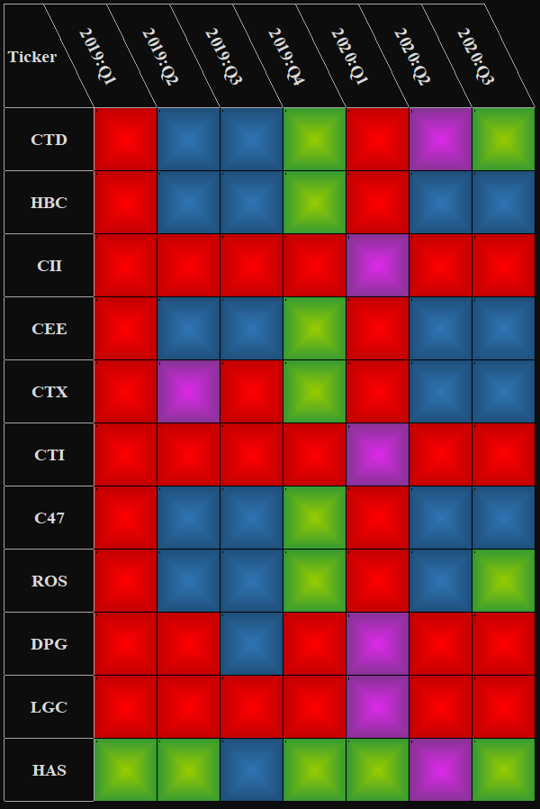
Industry: Construction – Key Players at A Glance

Slide 8
Coteccons Construction Joint Stock Company – HOSE: CTD
This model performed fairly well on CTD
It predicted the downturn in 2019:H1.
It showed some signs of recovery in 2019:Q4
The recovery was confirmed since 2020:Q2

Slide 9
Hoa Binh Construction Group Joint Stock Company – HOSE: HBC
This model apparently could not explain HBC in 2020
The model consistently showed ominous prospect of HBC in the first 3 quarters of 2020
HBC has doubled in price since 2020:Q2 in contempt of its DDD,DD,D classification

Slide 10
Industry: Banking – A Look at Dominators

Slide 11
Vietnam Prosperity Joint Stock Commercial Bank – HOSE: VPB
This model worked effectively on VPB
It predicted the price upsurge in the beginning of 2020, before badly hit by COVID-19
The model, which completely relied on fundamentals, was not able to foretell sudden sell-off due to COVID-19
When market sentiment improved and stock prices eventually aligned with fundamentals, this model did its good job

Slide 12
Bank for Foreign Trade of Vietnam – HOSE: VCB
The model could not explain VCB
The model casted a negative eye on VCB in general
But VCB persistently goes up in price since 2019

Slide 13
How it performed on the whole market?

Slide 14
Limitations & Solutions
Why the model worked best in some cases and failed to explain many others?

Slide 15
Unclustering Phenomenon
What we badly want:
How the data could be:
Group 1
Great Overlapping Area
Small Overlapping Area
Group 1
Group 2
Group 2

Slide 16

Possible Reasons:
Complex Reality
Variable Selection
K-Means algorithm might not be sophisticated enough
14 financial ratios in CAMEL method might not be adequate
Industry Classification
Taking incomparable companies into the same industry group

Slide 17
So… What’s next?
How we should proceed?
Step 1: Re-create Industry Classification Standard
Step 2: Adopt more potential variables
Step 3: Try with other algorithms
There are two possible ways to accomplish this:
Fundamental approach: Try with many traditional Industry Classification Standards to see which one work best
Statistical approach: Bootstrap or Cross-Validation
After we get a basket of “potential” variables, we shall use Bootstrap and/or Cross Validation to retain key variables, eliminate the rest
Random Forest is suggested

Slide 18




Thank You
Hiep Dang
+84 912 801 714
hiepdang@phs.vn
www.phs.vn

